Slide 1
E-Commerce
ELECTRONICS
Digital Egypt Pioneers Initiative
01

Slide 2
TEAM MEMBERS
Hager Haytham Fathy
Heba Mohamed Helmy
Maria Jan Hanna
Nour Adel Mohamed
Digital Egypt Pioneers Initiative
02

Slide 3
01
Digital Egypt Pioneers Initiative
Idea & Objectives
03

Slide 4
Idea
The project is an e-commerce platform specialized in electronics. It aims to provide a seamless shopping experience for customers looking to purchase electronic products online.
Objectives
Digital Egypt Pioneers Initiative
To create a user-friendly online marketplace for electronic products.
To offer a secure and efficient shopping experience through a set of well-designed features.
04

Slide 5
features
Below are some of the key features provided by the platform:
Users can register for a new account.
Users can log in to their account.
Users can browse through available products.
Users can add products to the shopping cart.
Users can remove products from the shopping cart.
Users can pay for their orders using a credit card.
Admin users can log in as admins.
Admin users can add new products to the platform.
Admin users can upload product images and set the product price.
Digital Egypt Pioneers Initiative
05

Slide 6
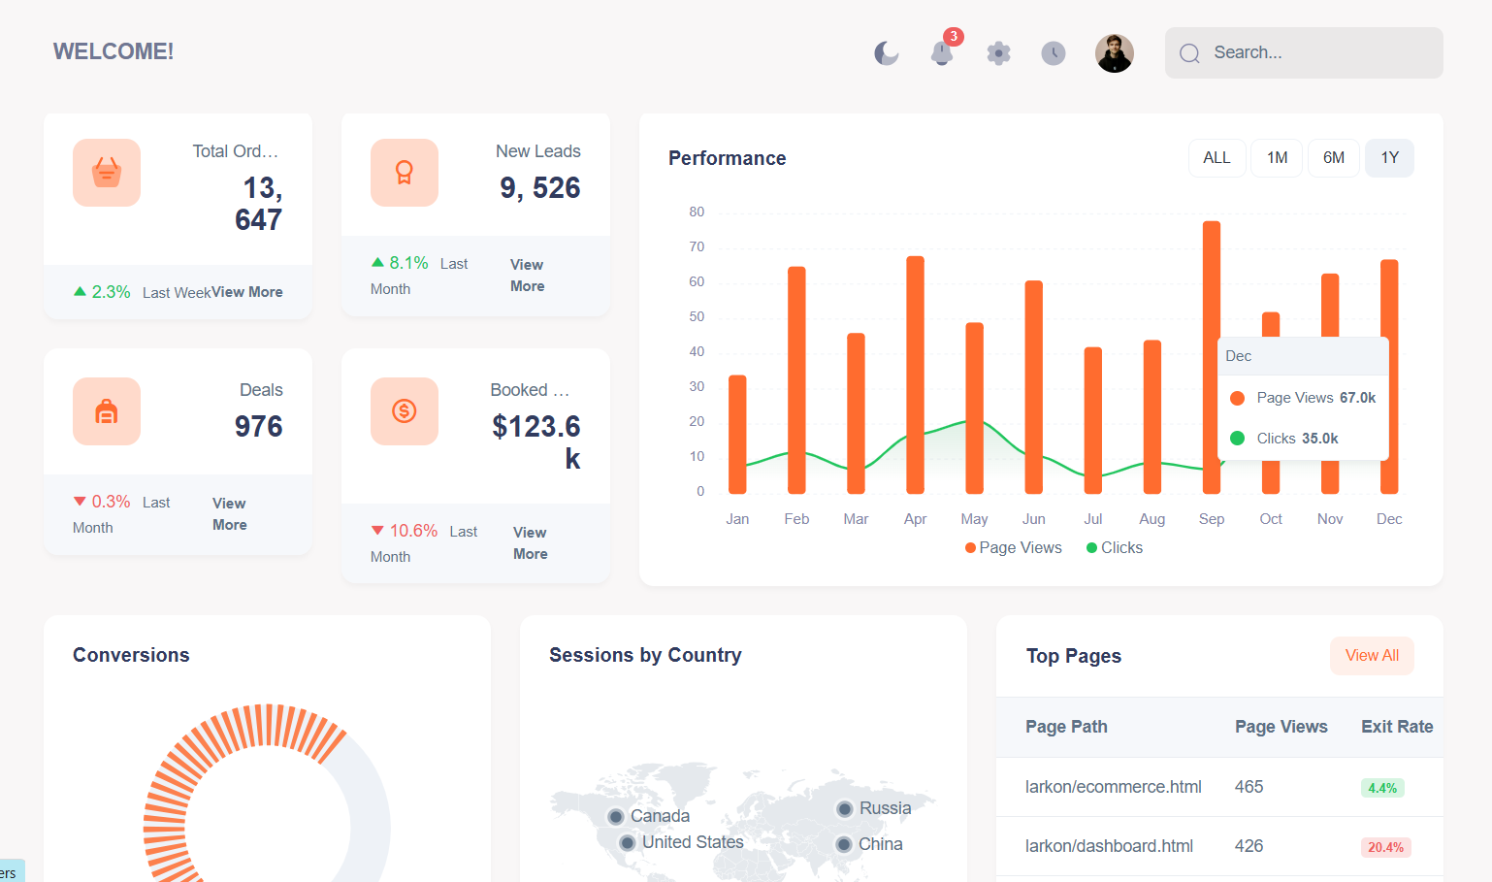
Features - Admin Dashboard
Digital Egypt Pioneers Initiative
06

Slide 7
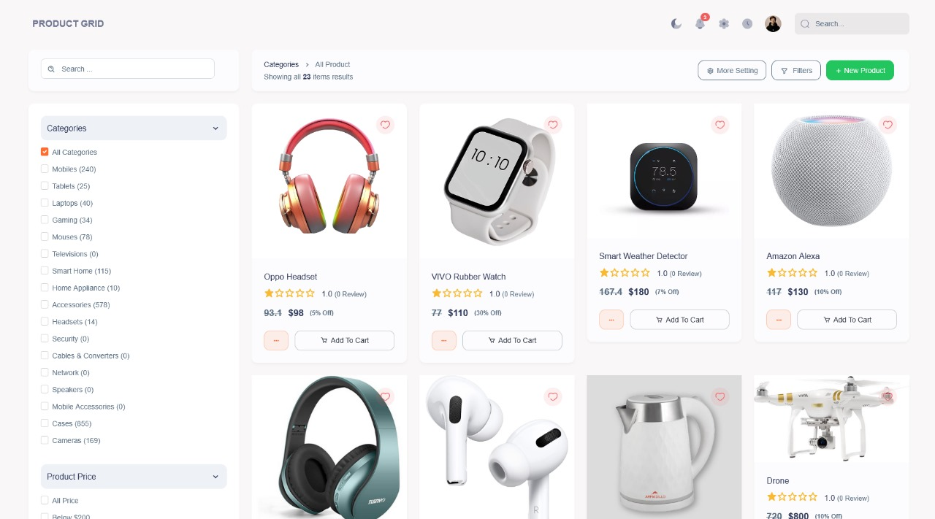
Features - Browsing Products
Digital Egypt Pioneers Initiative
07

Slide 8
02
Digital Egypt Pioneers Initiative
System Analysis Design
08

Slide 9
The system is built using the Clean Architecture pattern for better structure and maintainability.
The project is organized into three main layers:
Presentation Layer: Contains the UI and APIs, developed using Razor Pages.
Service Layer: Handles business logic and application rules.
Data Access Layer: Responsible for communicating with the database.
The database is designed to store:
User accounts
Product details
Order records
Shopping carts We used SQL Server as the database management system.
Digital Egypt Pioneers Initiative
09

Slide 10
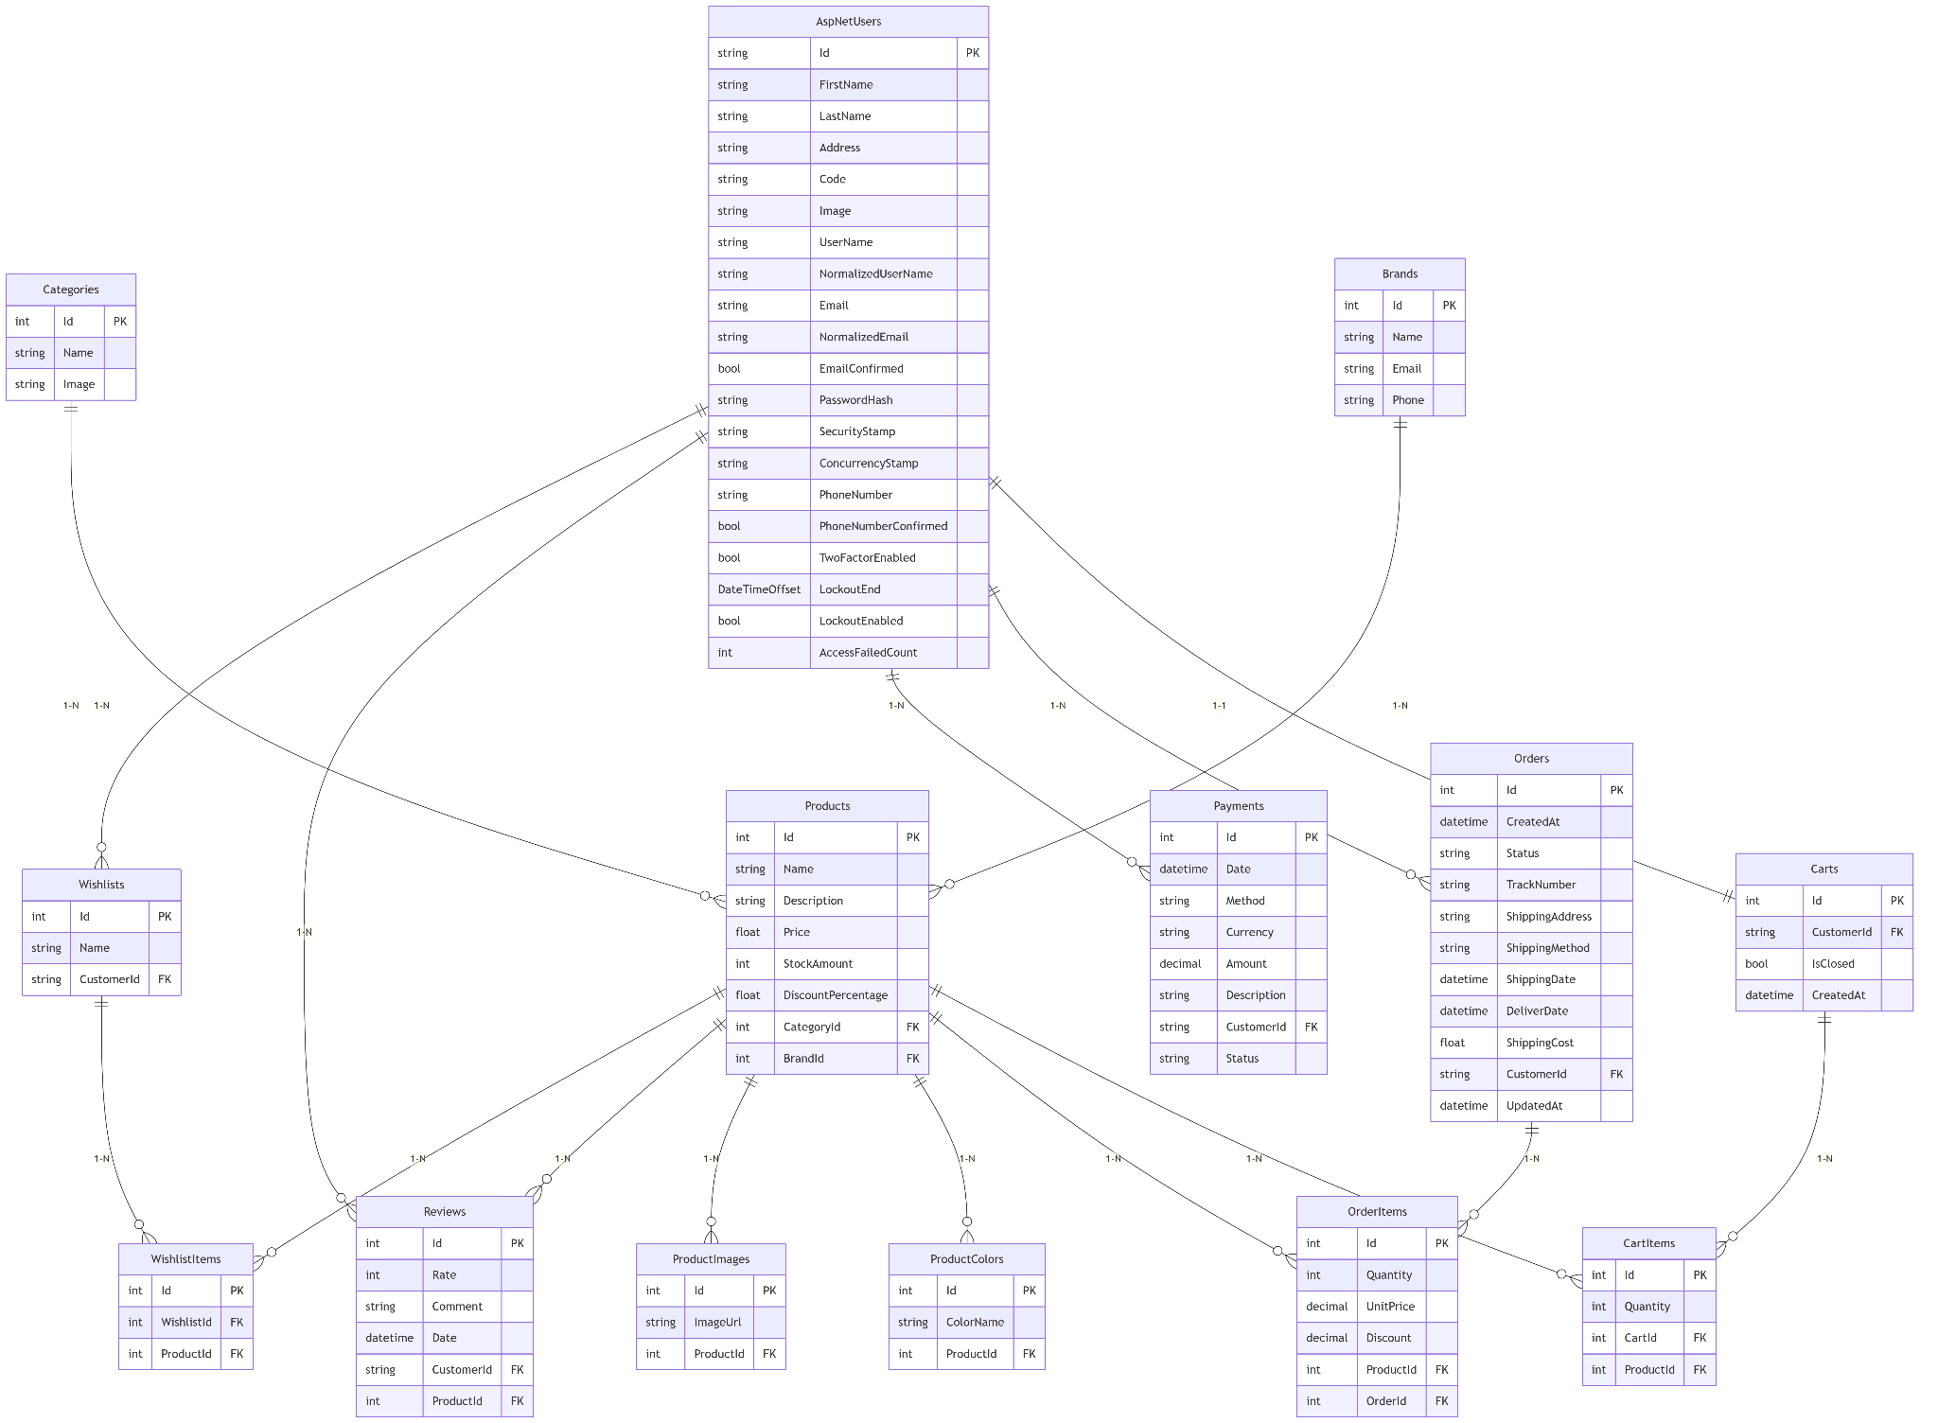
ER Diagram
Digital Egypt Pioneers Initiative
10

Slide 11
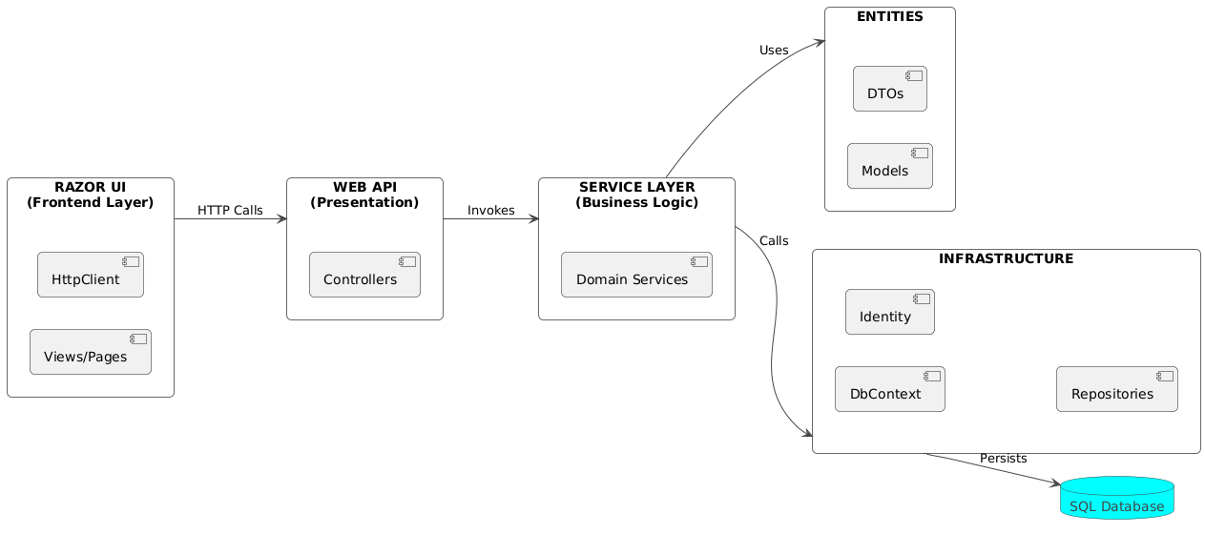
System Architecture
Digital Egypt Pioneers Initiative
11

Slide 12
03
Digital Egypt Pioneers Initiative
Algorithms / Techniques
12

Slide 13
We used SQL Server to store all application data such as users, products, and orders.
To interact with the database, we implemented:
The Repository Pattern to separate data access logic from business logic.
The Unit of Work Pattern to group related operations and save them in one transaction.
The Service Layer contains all the business logic such as:
Adding/removing items from the cart
Calculating total price
Processing payments
Validating data before saving
We built RESTful APIs to allow the frontend (UI) to send and receive data from the backend in a structured way.
The Presentation Layer is developed using Razor Pages, which communicate with the APIs and display data to the user.
Digital Egypt Pioneers Initiative
13

Slide 14


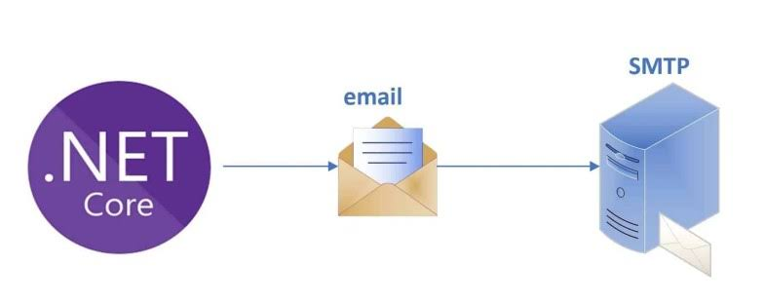
Algorithms/ Techniques
We used:
Identity Framework for user authentication and authorization.
Stripe for Payment integration.
Mailkit .Net SMTP for sending verification emails through smtp server.
Digital Egypt Pioneers Initiative
14

Slide 15
04
Digital Egypt Pioneers Initiative
Sequence Diagrams
15

Slide 16
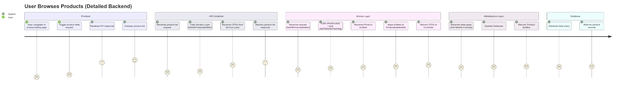
User Browses Products - detailed journey
16

Slide 17
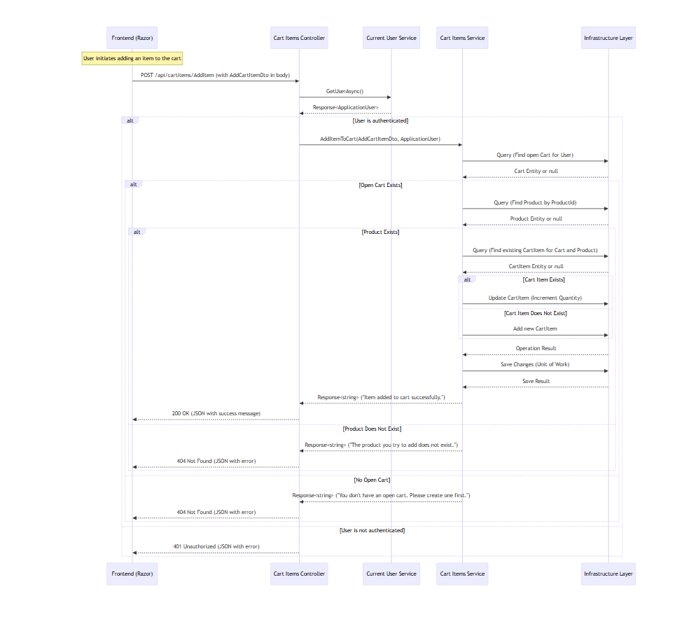
User Adds Item to Cart - Sequence Diagram
17

Slide 18
05
Digital Egypt Pioneers Initiative
Testing and Documentation
18

Slide 19
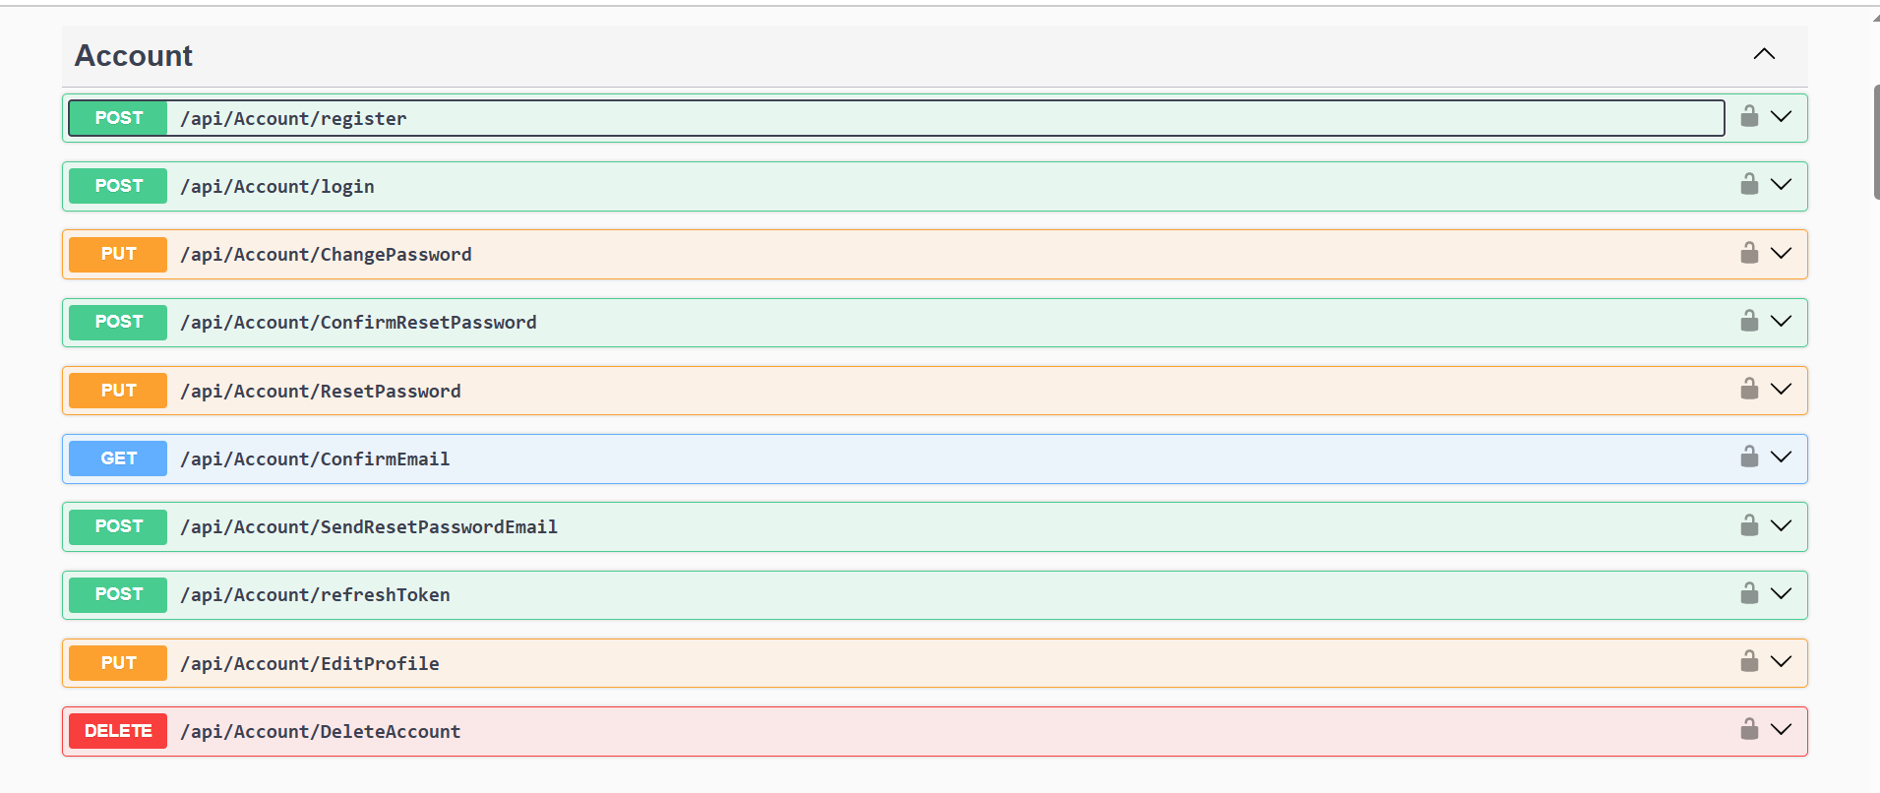
Swagger
Digital Egypt Pioneers Initiative
19

Slide 20
Thanks for listening
Digital Egypt Pioneers Initiative
20

